Slide 1
Business Communication Introduction Dr. Clara Ma

Slide 2

Dr. Clara Fangfang Ma
Doctorate in Entrepreneurial Leadership
Master in Educational Leadership
Both from Johns Hopkins University
Work: Professor; Scientist; Writer; Entrepreneur; Mother; Diver
History: TV Host; United Nation Interpreter; K-12 Teacher;
Interested in connecting with: Knowledge seekers; Job applicants; Kind people

Slide 3

Character and Skills
Be on time
Listen actively
Speak up
Plagiarism with AI
15% of the final grade

Slide 4
Meeting someone new? Choose a style based on your goal & audience
TO NETWORK
Ask questions & connect
Honest compliment
Exchange names
Ask for something easy
TO PITCH YOURSELF
Your name
3 keywords for your interests
(“I work at the intersection of X, Y, Z”)
State your goal & ask for help
Notes:
Dr. Marcia

Slide 5
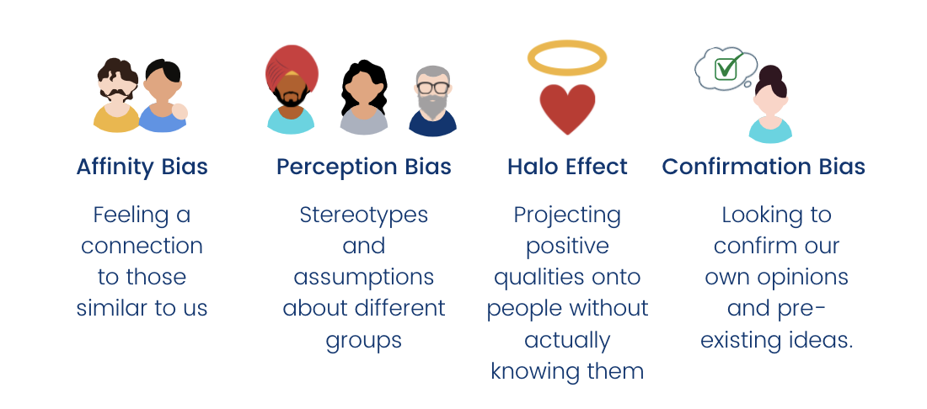

Slide 6

A Great Introduction for Later in Your Career
“I help” + group / type of people + result you help them achieve
Keep it short and sweet to invite curiosity
Answer questions with stories about what you helped others achieve
Firm handshake please!
https://theartofcharm.com/podcast-episodes/clay-hebert-the-perfect-intro-episode-555/
Image Source: Getty Images

Slide 7
The Cheat Sheet (Role Play Time):
Learn how to tailor the introduction of yourself and your business to suit the crowd and room where you are.
How do you introduce others to one another in an effective way that makes everyone look good?
What they learned about their classmates.
How they felt introducing someone else.
The importance of listening and paying attention when networking.

Slide 8
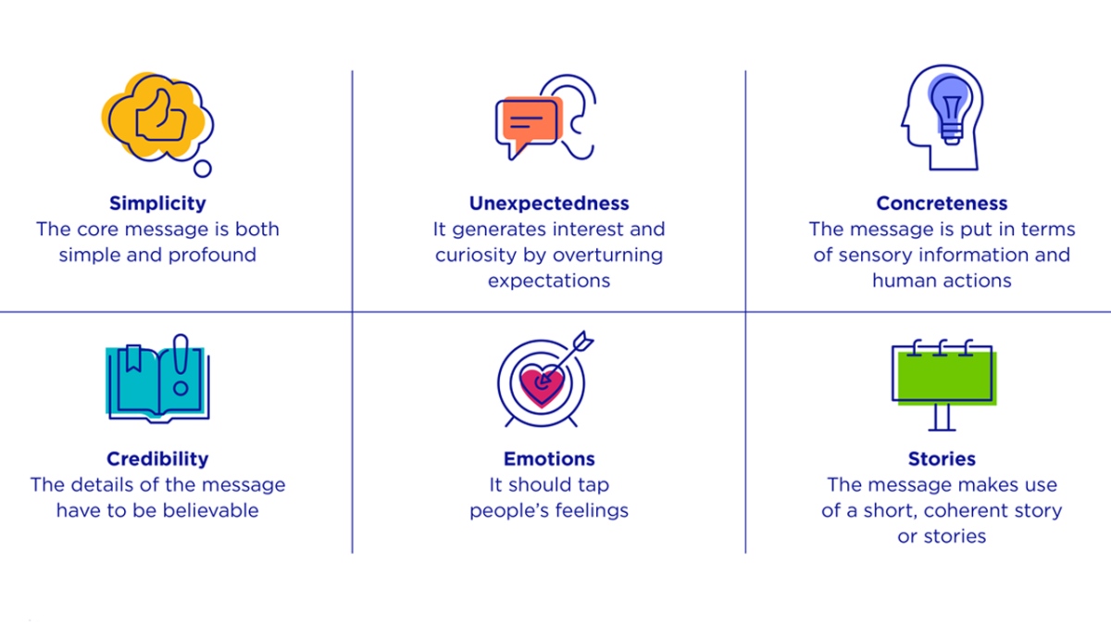
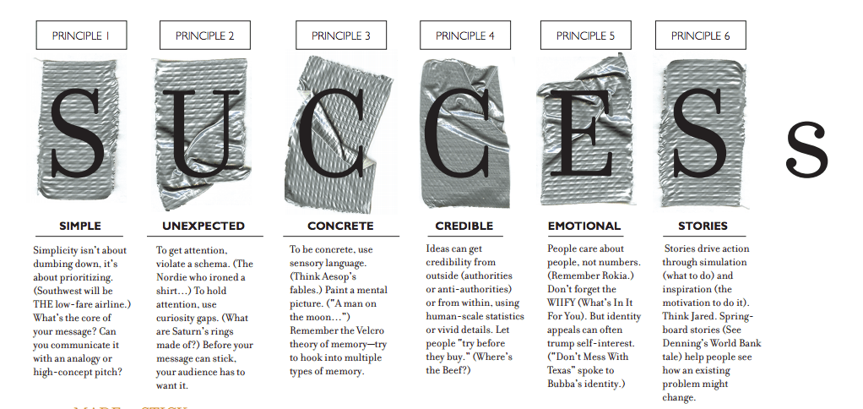
You can make sure your stories “stick” with
Source: Chip and Dan Heath, Made to Stick

Slide 9
Which principle matters to you the most? Kahoot

Slide 10
Turn and Talk
Tell us one time you have had a miscommunication, how you wish to solve this? Remember: Simple; Unexpected; Concrete; Credible; Emotional; Stories

Slide 11
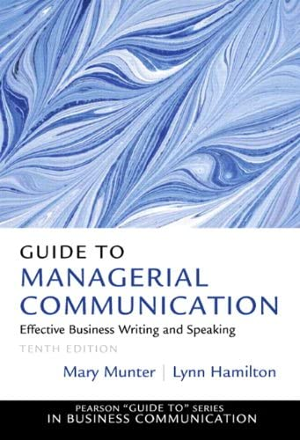


Slide 12
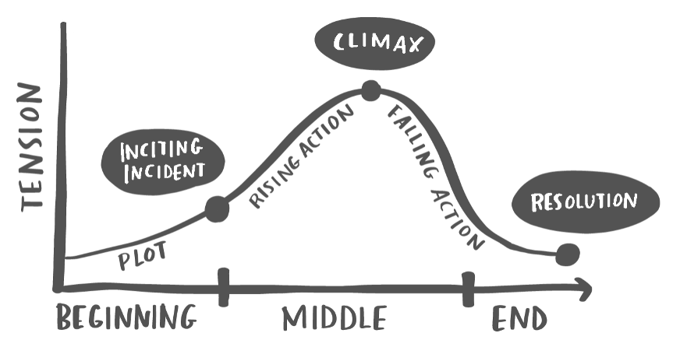
What is a story?
Storytelling with Data
Storytelling with Data
A status quo (everything’s fine…)
That gets disrupted → a problem emerges
The solution creates a new order that’s better than the status quo
Notes:
Status Quo (everything's fine...): In a small seaside village, the townspeople have always relied on traditional rowboats to fish. Every morning, they would row out to sea, fish for hours, and return by sunset. It was hard work, but life was peaceful and predictable.
Disruption (a problem emerges): One summer, an unexpected and prolonged storm disrupted the sea routes. The waves were too high and dangerous for rowboats, and the village faced the threat of running out of food as their primary means of livelihood was compromised.
Solution (a new order that's better than the status quo): A young innovator in the town introduced a design for a more stable, sail-assisted fishing boat that could handle the rough waters and even reach further fishing spots more quickly. Initially met with skepticism, a brave group decided to try it. The new boats not only allowed the villagers to fish during the stormy season but also increased their catch, leading to prosperity and a new era of innovation for the village. The village was now not only resilient to future storms but also had the means to explore and trade with neighboring islands.

Slide 13

Healthy eating is hard to motivate
Imagine you are in advertising. You want to convey to the general public (via a print ad) that movie theater popcorn is unhealthy. A medium bag contains 37 grams of saturated fat.

Slide 14
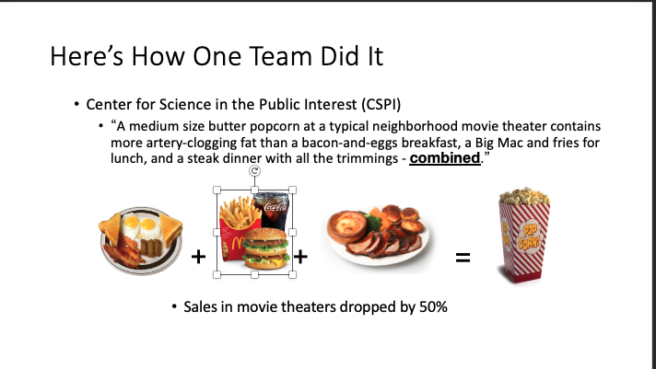
Here’s How One Team Did It
Notes:
WHY is it effective?

Slide 15
Persuasion
Why was this advertisement persuasive/influential?
Simplified, gets to the core of the idea
Surprising, unexpected
Concrete instead of abstract
Credible, believable, trustworthy source
Elicits emotional reactions
Tells a story
Notes:
I’d now like to turn to a discussion of the features of a sticky message, or what makes ideas stick. A lot of this lecture will be based upon a book that one of my graduate school professors wrote, a man named Chip Heath. He has studied what makes some ideas go viral, and why some ideas are stickier than others. It is similar to Malcolm Gladwell’s book, The Tipping Point, but Chip looks at some practical things that you can do to increase stickiness.
The goal of persuasive messages is to make the audience pay attention, understand, remember agree with you, care, and act. So it’s a long way from perceiving you to your message to understanding you and actually deciding to act. Most people think their kidney appeals sufficiently meet these goals… and they’d be right. But sufficient isn’t necessarily good enough. We’ll talk about 6 features of messages that can make your arguments go from good to great. By sticky, I mean memorable and easy to understand, but most of all, effective. So even if your message is, according to this taxonomy, the stickiest ever, you have to remember that your audience also gets a vote.
The way that we’ll do that is with a series of mini-cases that highlight the SUCCESs model.

Slide 16
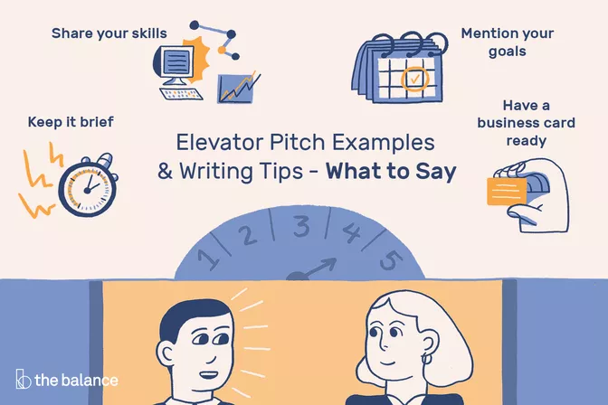
Part 1: Elevator speech
Notes:
https://www.youtube.com/watch?v=LDpe9StfGTA 2 mins video

Slide 17

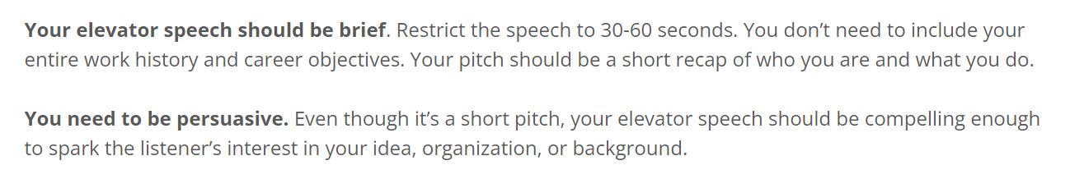
Elevator Pitch goals:

Slide 18
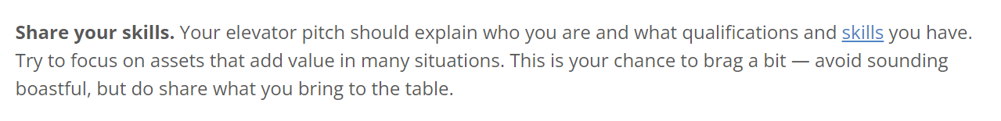
Elevator Pitch goals:

Slide 19
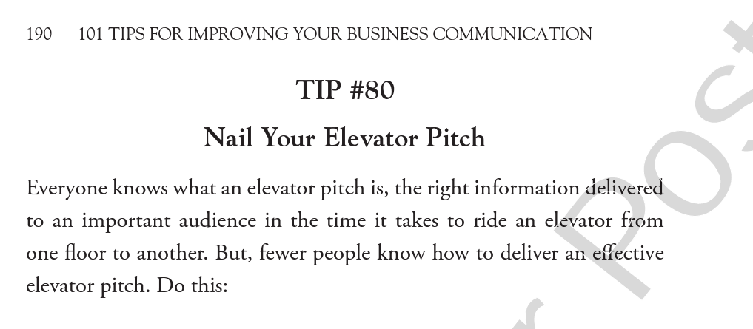

Slide 20
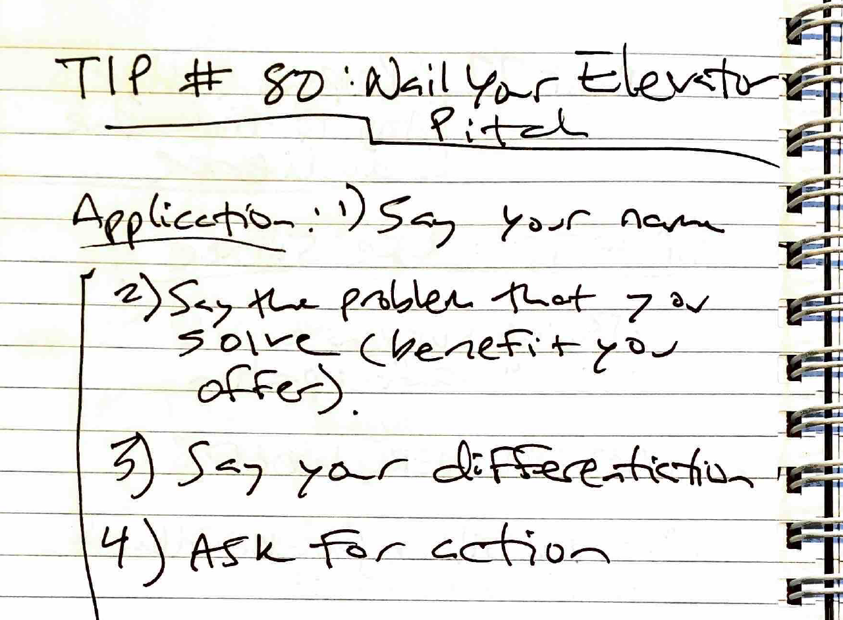

Slide 21
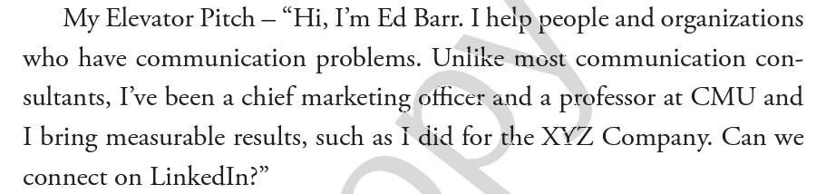

Slide 22
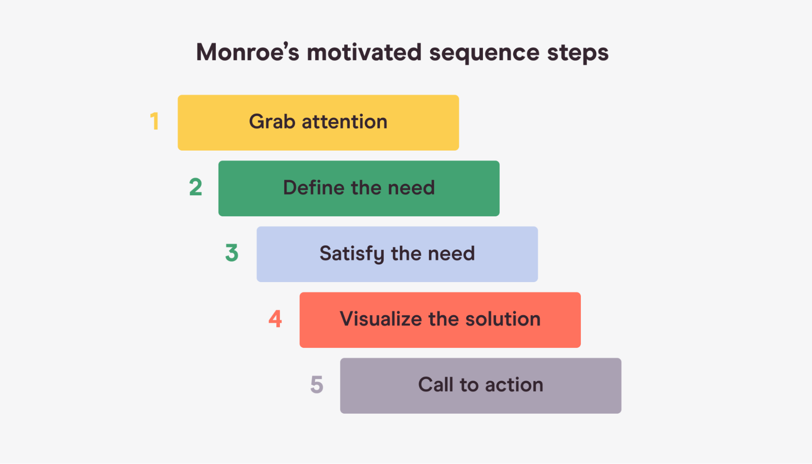
Monroe’s Motivated Sequence

Slide 23

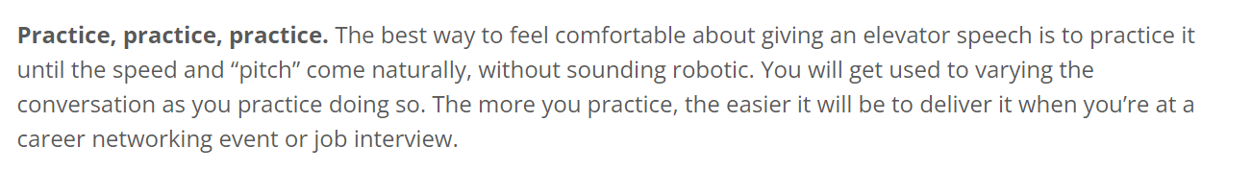
Elevator Pitch goals:
Notes:
Tell me what you are thinking

Slide 24
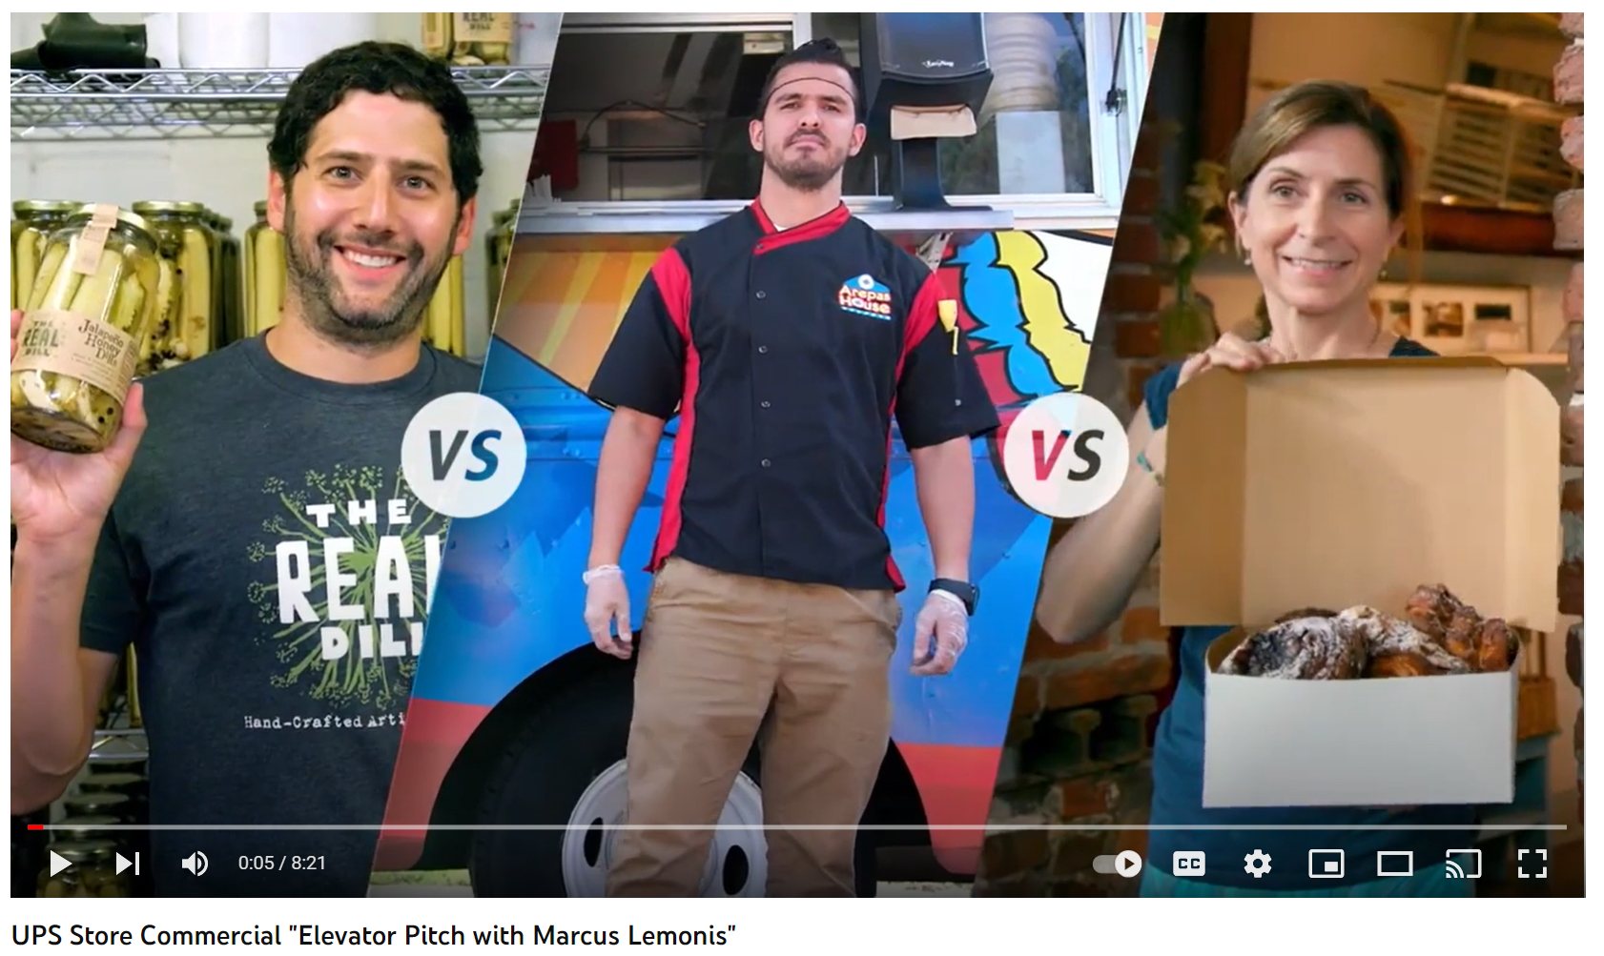
A) Elevator speech sample analysis

Slide 25
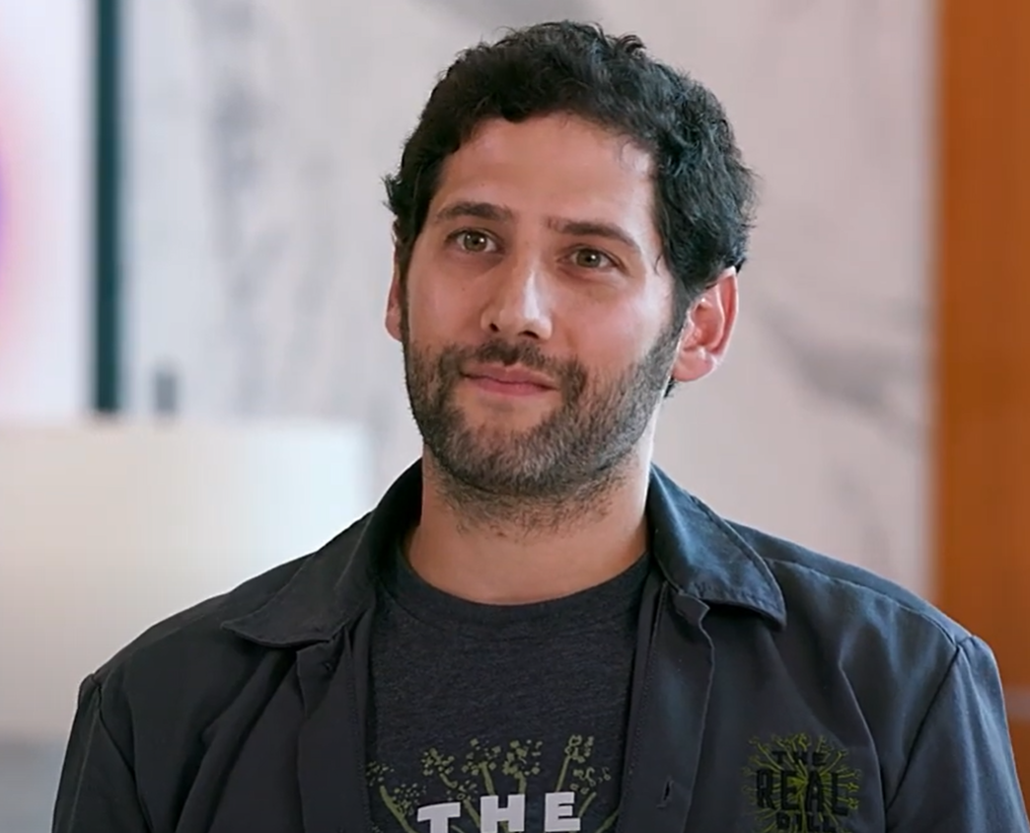
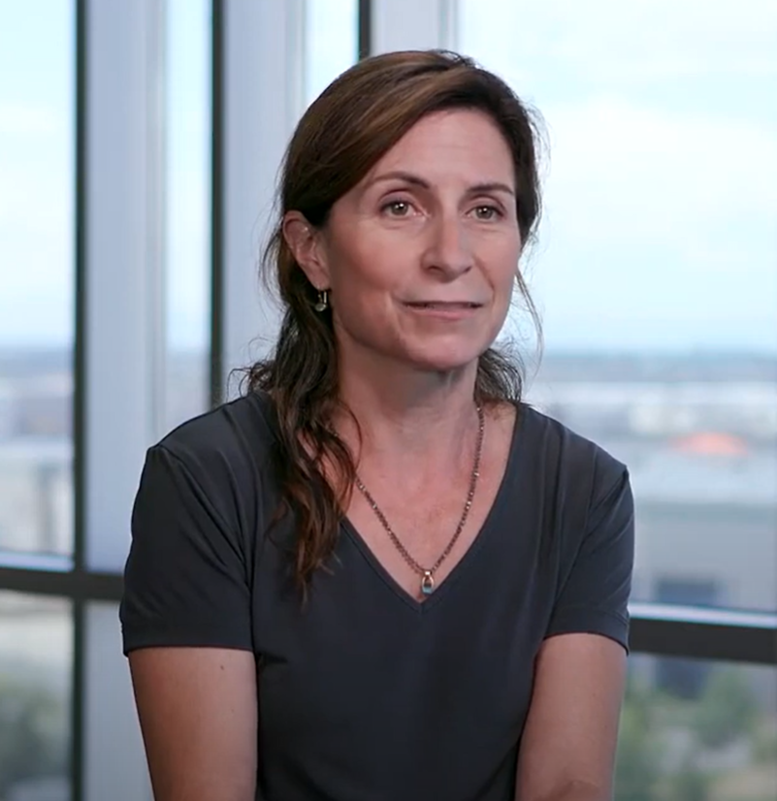
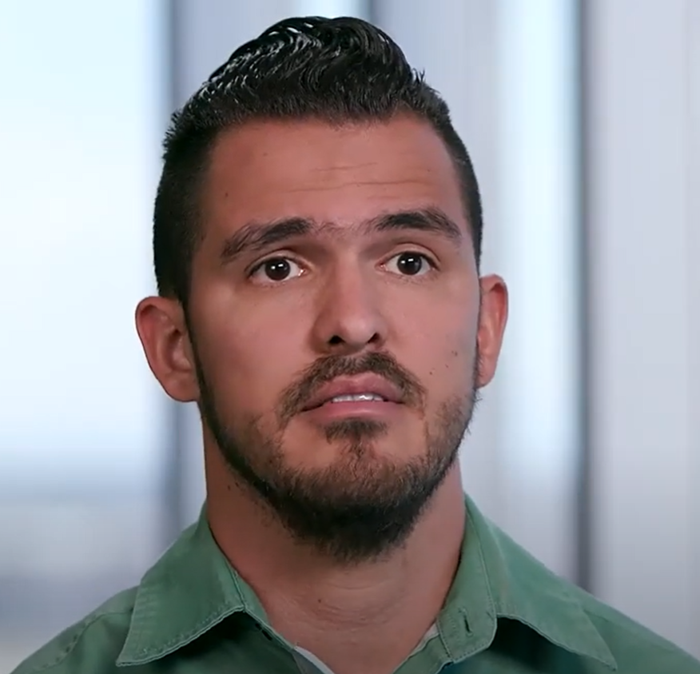
Presenters – let’s practice first
1
2
3
Justin
Katherine
Jorge

Slide 26

Notes:
https://youtu.be/5w9jqT8xzZk?si=HxN4OytoVIY_QZJS

Slide 27
Now, prepare for delivery
What is the key word are you thinking about?
https://create.kahoot.it/details/832965b0-e66f-4df3-ad62-3a886667ee31
Imagine you are the owner of a new business, OR, imagine you are a representative of a company presenting your product to your audience
Rehearse with your partner 1-2 times
Revise and rehearse by yourself for 5 minutes
Present!

Slide 28
Debriefing discussion questions: Elevator Speech
What was the most challenging aspect of creating your elevator pitch? How did you overcome it?
What strategies did you use to make your elevator speech memorable and engaging to the listener?
How did peer feedback influence your final pitch?
Were there any surprises or unexpected reactions when you presented your elevator speech to others?
Looking back, what would you do differently? What did you learn from this exercise that you can apply in future professional situations?
Notes:
Slido or kahoot takeaways

Slide 29
Book review: come up with one multiple choices question on discussion board: Book: Duarte Group 1 – Section 2 Group 2 – Section 3 Group 3 – Section 4 Group 4 – Section 5 Group 5 – Section 2 Group 6 – Section 3 Group 7 – Section 4

Slide 30

Class 2: Strategic COMM
Activity 1: Elevator Speech
BREAK
Activity 2: Unify and present: Using Monroe's Motivated Sequence (MMS) in Team Presentation

Slide 31

Team work and presentation
Problems and solutions

